Slide 1
Software Design and Architecture
Introduction to Refactoring

Slide 2
What is Refactoring
Refactoring is the process of changing a software system such that
the external behavior of the system does not change
e.g. functional requirements are maintained
but the internal structure of the system is improved
This is sometimes called
“Improving the design after it has been written”

Slide 3
The idea behind refactoring is to acknowledge that it will be difficult to get a design right the first time and, as a program’s requirements change, the design may need to change
refactoring provides techniques for evolving the design in small incremental steps

Slide 4
(Very) Simple Example
Consolidate Duplicate Conditional Fragments; This
if (isSpecialDeal()) {
total = price * 0.95;
send()
} else {
total = price * 0.98;
send()
}
becomes this
if (isSpecialDeal()) {
total = price * 0.95;
} else {
total = price * 0.98;
}
send();

Slide 5
(Another) Simple Example
Replace Magic Number with Symbolic Constant
double potentialEnergy(double mass, double height) {
return mass * 9.81 * height;
}
becomes this
double potentialEnergy(double mass, double height) {
return mass * GRAVITATIONAL_CONSTANT * height;
}
static final double GRAVITATIONAL_CONSTANT = 9.81;

Slide 6
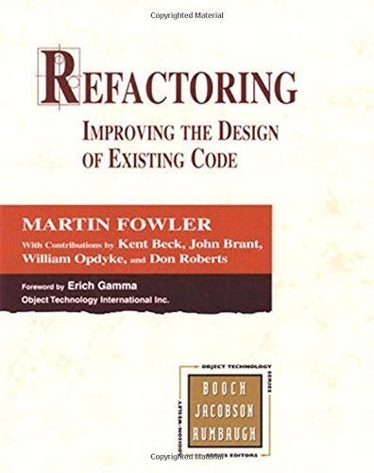
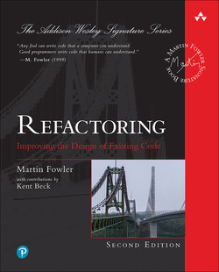
A “cookbook” can be useful
Refactoring: Improving the Design of Existing Code
by Martin Fowler (and Kent Beck, John Brant, William Opdyke, and Don Roberts)

Slide 7
How do you make refactoring safe?
Test constantly!
This ties into the agile design paradigm
you write tests before you write code
after you refactor, you run the tests and check that they all pass
if a test fails, the refactoring broke something but you know about it right away and can fix the problem before you move on

Slide 8
Refactoring: Where to Start?
How do you identify code that needs to be refactored?
Look for “Bad Smells” in Code
A very valuable chapter in Fowler’s book
It presents examples of “bad smells” and then suggests refactoring techniques to apply

Slide 9
Bad Smells in Code
Duplicated Code
bad because if you modify one instance of duplicated code but not the others, you (may) have introduced a bug!
Long Method
long methods are more difficult to understand
performance concerns with respect to lots of short methods are largely obsolete

Slide 10
Bad Smells in Code
Large Class
Large classes try to do too much, which reduces cohesion
Long Parameter List
hard to understand, can become inconsistent if the same parameter chain is being passed from method to method
Divergent Change
symptom: one type of change requires changing one subset of methods; another type of change requires changing another subset
Related to cohesion

Slide 11
Bad Smells in Code
Shotgun Surgery
a change requires lots of little changes in a lot of different classes
Feature Envy
A method requires lots of information from some other class
Data Clumps
attributes that clump together (are used together) but are not part of the same class

Slide 12
Bad Smells in Code
Primitive Obsession
characterized by a reluctance to use classes instead of primitive data types
Switch Statements
Switch statements are often duplicated in code; they can typically be replaced by use of polymorphism (let OO do your selection for you!)
Parallel Inheritance Hierarchies
Similar to Shotgun Surgery; each time we add a subclass to one hierarchy, we need to do it for all related hierarchies
Note: some design patterns encourage the creation of parallel inheritance hierarchies (so they are not always bad!)

Slide 13
Bad Smells in Code
Lazy Class
A class that no longer “pays its way”
e.g. may be a class that was downsized by a previous refactoring, or represented planned functionality that did not pan out
Speculative Generality
“Oh we think we need the ability to do this kind of thing someday”
Temporary Field
An attribute of an object is only set/used in certain circumstances;
but an object should need all of its attributes

Slide 14
Bad Smells in Code
Message Chains
a client asks an object for another object and then asks that object for another object etc. Bad because client depends on the structure of the navigation
Middle Man
If a class is delegating more than half of its responsibilities to another class, do you really need it? Involves trade-offs, some design patterns encourage this (e.g. Decorator)
Inappropriate Intimacy
Pairs of classes that know too much about each other’s implementation details (loss of encapsulation; change one class, the other has to change)

Slide 15
Bad Smells in Code
Data Class (information holder)
These are classes that have fields, getting and setting methods for the fields, and nothing else; they are data holders, but objects should be about data AND behavior
Refused Bequest
A subclass ignores most of the functionality provided by its superclass
Subclass may not pass the “IS-A” test
Comments (!)
Comments are sometimes used to hide bad code
“…comments often are used as a deodorant” (!)

Slide 16
The Catalog
The refactoring book has 72 refactoring patterns!
Some of common ones:
Extract Method
Replace Temp with Query
Move Method
Replace Conditional with Polymorphism
Introduce Null Object
Separate Query for Modifier
Introduce Parameter Object
Encapsulate Collection
Replace Nested Conditional with Guard Clauses

Slide 17
Extract Method
• You have a code fragment that can be grouped together
• Turn the fragment into a method whose name explains the purpose of the
fragment

Slide 18
Example

Slide 19
Replace Temp with Query
You are using a temporary variable to hold the result of an expression
Extract the expression into a method;
Replace all references to the temp with the expression.
The new method can then be used in other methods

Slide 20
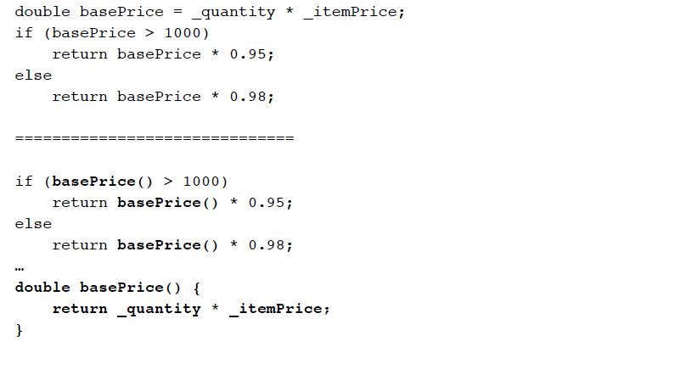
Example

Slide 21
Move Method
A method is using more features (attributes and operations) of another class than the class on which it is defined
Create a new method with a similar body in the class it uses most. Either turn the old method into a simple delegation, or remove it altogether

Slide 22
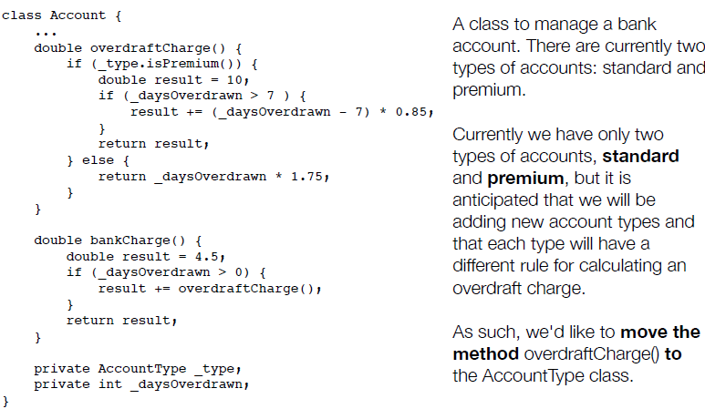
Move Method

Slide 23
Move Method
When moving a method to a new class, we examine its code to see if makes use of internal attributes of its original class
In this case, overdraftCharge() makes use of _daysOverdrawn
All such attributes become parameters to the method in its new home. (If the method already had parameters, the new parameters get tacked on to the end of its existing parameter list.)
In this case, _daysOverdrawn will stay in the Account class and be passed as a parameter to AccountType.overdraftCharge().

Slide 24
Move Method
Note, also, that since we are moving this method to the AccountType class, all calls to its methods that previously required a variable reference, can now be made directly
Thus, _type.isPremium() becomes simply isPremium() in the method’s new home

Slide 25
Move Method
Here is the method in its new home. It has a daysOverdrawn parameter, which is used instead of _daysOverdrawn, throughout the method.
_type.isPremium() is now just isPremium(), as advertised.

Slide 26
Move Method
Back in the Account class, we update overdraftCharge() to delegate to the overdraftCharge() method in the AccountType class. Or, we could…

Slide 27
Move Method
… get rid of the overdraftCharge() method in Account entirely. In that case, we move the call to AccountType.overdraftCharge() to bankCharge()

Slide 28
Replace Conditional with Polymorphism
You have a conditional that chooses different behavior depending on the type of an object
Move each “leg” of the conditional to an overriding method in a subclass. Make the original method abstract

Slide 29
Replace Conditional with Polymorphism

Slide 30
Replace Conditional with Polymorphism
With this configuration, you can now write code that looks like this:
and everything will work correctly via polymorphism and will be easy to extend: just add a new subclass to support a new type of bird

Slide 31
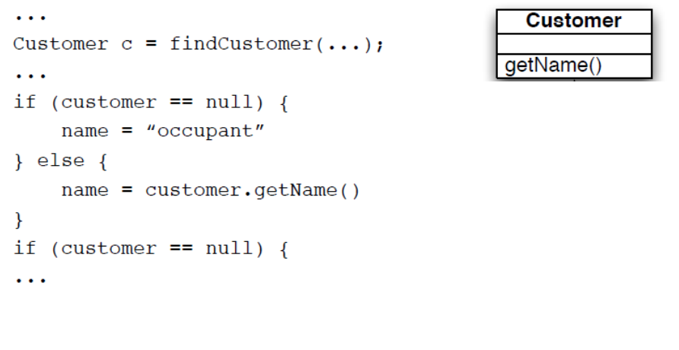
Introduce Null Object
Repeated checks for a null value (see below)
Rather than returning a null value from findCustomer() return an instance of a “null customer” object

Slide 32
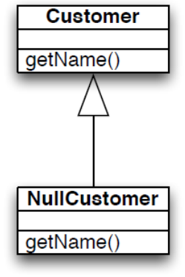
Introduce Null Object
The conditional goes away entirely!!

Slide 33
Separate Query for Modifier
Sometimes you will encounter code that does something like this
getTotalOutstandingAndSetReadyForSummaries()
It is a query method but it is also changing the state of the object being called
This change is known as a “side effect” because it’s not the primary purpose of the method

Slide 34
Separate Query for Modifier
It is generally accepted practice that queries should not have side effects so this refactoring says to split methods like this into:
getTotalOutstanding()
setReadyForSummaries()
Try as best as possible to avoid side effects in query methods

Slide 35
Introduce Parameter Object
You have a group of parameters that go naturally together
Stick them in an object and pass the object
Imagine methods like
amountInvoicedIn(start: Date; end: Date);
amountOverdueIn(start: Date; end: Date);
This refactoring says replace them with something like
amountInvoicedIn(dateRange: DateRange)
The new class starts out as a data holder but will likely attract methods to it

Slide 36
Encapsulate Collection
A method returns a collection
Make it return a read-only version of the collection and provide add/remove methods
Student class with
getCourses(): Map;
setCourses(courses: Map);
Change to
getCourses(): ReadOnlyList
addCourse(c : Course)
removeCourse(c : Course)
Changing the externally visible collection, too, is a good idea to protect clients from depending on the internals of the Student class

Slide 37
Replace Nested Conditional with Guard Clauses
This refactoring relates to the purpose of conditional code
One type of conditional checks for a variation in “normal” behavior
The system will either do A or B, both are considered “normal” behavior
The other type of conditional checks for unusual circumstances that require special behavior; if all of these checks fail then the system proceeds with “normal behavior”
We want to apply this refactoring when we discover the latter type of conditional

Slide 38
Example
Note: This type of code may be the result of a novice programmer or due to a programming constraint imposed by
some companies that a method can only have a single return.
Often this constraint
causes more confusion
than its worth

Slide 39
Example
double getAmount() {
if (_isDead) return deadAmount();
if (_isSeparated) return separatedAmount();
if (_isRetired) return retiredAmount();
return normalAmount();
}
With this refactoring, all of the code trying to identify special
conditions are turned into one-line statements that determine whether the condition applies and if so handles it
That’s why these statements are called “guard clauses”
Even though this method has four returns, its easier to
understand than the method before the refactoring

Slide 40
Common Situation: Need to reverse conditionals
Sometimes complex compound conditionals can be converted into guard clauses by reversing the condition that is being tested
By reversing the conditionals and “failing early” you simplify the code

Slide 41
Example

Slide 42
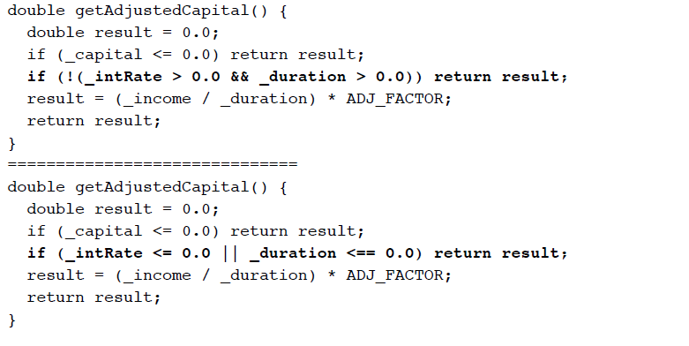
Example

Slide 43
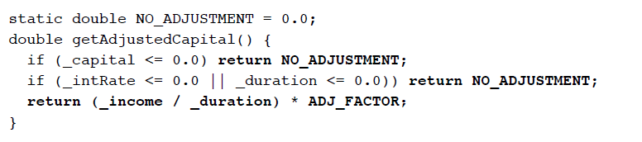
Example
In this final step
we can eliminate the temporary variable altogether,
replace 0.0 with a constant that provides semantic meaning, and just return the adjusted capital without storing it in a temp first.
The resulting method is simpler, shorter, easier to understand

